Slide 1
DS Growth Case Study
Bijan Seyednasrollah November 2020

Slide 2
Table of content
Problem Statement
Workflow
Preprocessing
Processing
Post-processing
Engineering Architecture and Trade-Offs:
Business Performance and ROI

Slide 3
Problem Statement
We want to predict the probability of “activation” based on the following data per click using data from Google Adwords.
1. created_date - date on which the click was recorded
2. location_in_query - city name that appeared in search query
3. platform - platform such as web/mobile
4. campaign_state - US state where the ad campaign was run
5. in_city - whether the ad campaign was run in a city or not
6. is_prime - whether the word fico prime appeared in the search query
7. is_hardship - whether the word hardship appeared in the search query
8. category_debt_type - type of debt solution that appeared in the search query
9. is_activated[TARGET] – whether the user talked to FFN call center or not

Slide 4
I developed the workflow in TensorFlow, summarized below.
Raw data
Preprocessing
Cleaned and organized data
Model-ready data
Model
Evaluation
Processing
Model Tuning
Test
Post-processing
Post-processing
Interpretation

Slide 5
Preprocessing
There are several challenges regarding the dataset that should be properly addressed before feeding it into the model:
Missing data
Imbalanced classes
Incorporating date and time
Multi data types and hyper-categorical data
I address each challenge by performing several steps as follows.

Slide 6
Preprocessing- Missing Data (Imputation)
The table below shows number of missing values for each variable:
created_date 0
location_in_query 15
platform 0
campaign_state 6
in_city 0
is_prime 0
is_hardship 0
is_activated 0
category_debt_type 9859
time_index 0
Several columns contain missing data points that should be imputed, including: location_in_query, campaign_state, category_debt_type.
For the most part, I used majority voting to impute missing values for the above columns. I also replaced invalid state name with ‘fl’ which was the majority class. The missing location_in_query were replaced by ‘unknown_location’

Slide 7
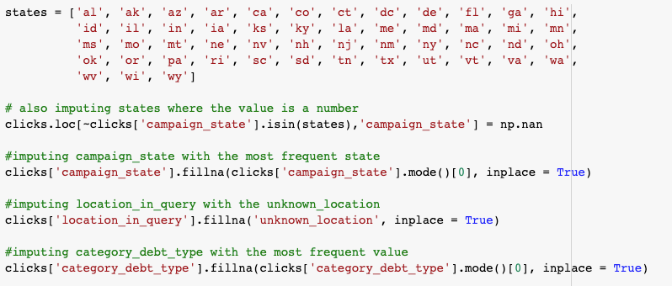
Preprocessing- Imputation (Code)

Slide 8
Preprocessing- Imbalanced Classes
The label data is highly imbalanced:
87407 as is_activated=1
6787 as is_activcated=0
This could be a major problem if properly not resolved. There are several ways to tackle this issue: oversampling the minority class, under-sampling the majority class and assigning weights to each class in the loss function.
I took a hybrid approach: To avoid removing information, I picked the oversampling methods rather than the under-sampling method; but I also slightly adjusted the weights to improve the convergence of the model towards giving more importance to the is_activated data (0.85 vs. 1). This could vary based on the goal of the model, that I will later discuss.

Slide 9
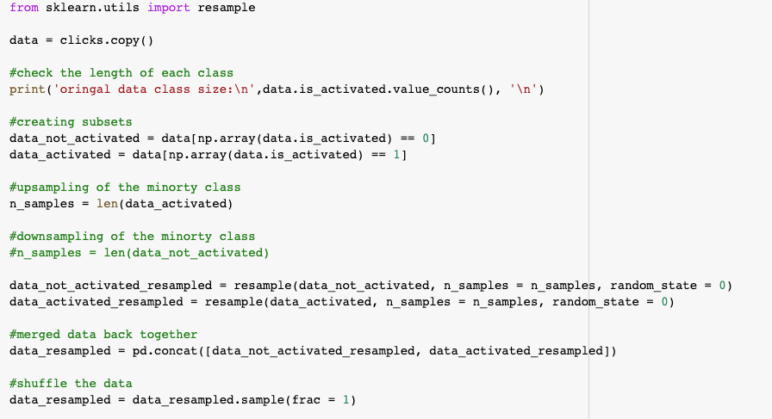
Preprocessing- Imbalanced Classes (Code)

Slide 10
Preprocessing- Incorporating Date/Time
There is a date column (created_date) in the dataset that includes information about the time of the click. However there are only 32 unique values across the entire 94,000+ observations.
I used datetime data represented in two different formats:
1- As a categorical variable: I will later explain how to handle categorical data
2- As a continuous scaled number from 0 to 1 (named as ‘time_index’): First converting to seconds, then scaling between 0 and 1.

Slide 11
Preprocessing- Multi-datatype
As the features include numerical, binary and categorical data, I needed to make them ready for my model.
To accomplish this, I used the feature_column module from tensorflow and converted all variables either to numerical vectors, multi-dimensional embedded matrices, or crossed hashed data, as follows:
Vectors: for numeric variables: 'in_city', 'is_prime', 'is_hardship', 'time_index'
Categorical matrics: for multicategorical variables: platform', 'category_debt_type'
Embedded matrices: for hyper-categorical variables: 'created_date', 'campaign_state'
Crossed columns: for combination of 'campaign_state' and ‘location_in_query’

Slide 12
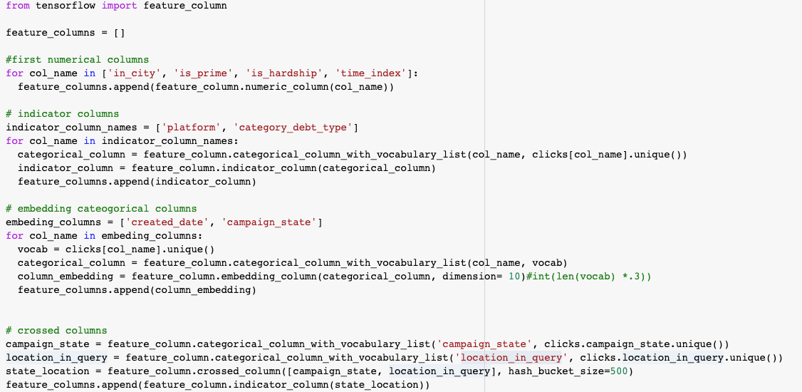
Preprocessing- Multi-datatype (Code)

Slide 13
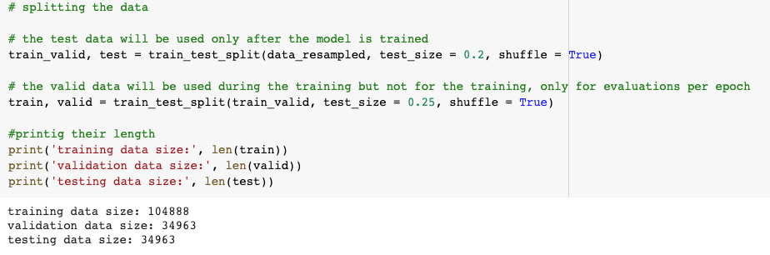
Preprocessing - Train-Validation-Test Split
It is important to split the data into three parts:
Training data: used to train the model
Validation data: used to validate the model on the fly
Test data: used to evaluate the model after it is fitted.

Slide 14
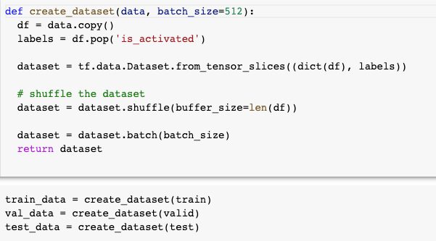
Preprocessing- TensorFlow Ready Datasets
To prepare the input data for the TensorFlow data pipeline, we need to put to in sliced batches of tensors.

Slide 15
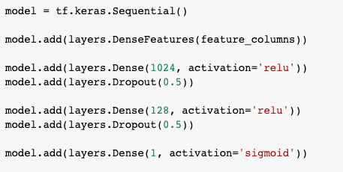
Processing - Model Structure
I used a neural network model with four main layers:
An input layer of all features
A dense layer of 1024 neurons with 50% dropout and ‘ReLU’ activation
A dense layer of 128 neurons with 50% dropout and ‘ReLU’ activation
A final single neuron layer of outputs with ‘sigmoid’ activation

Slide 16
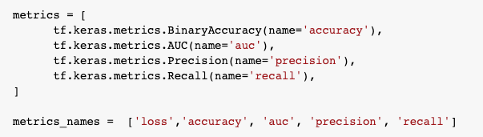
Processing - Model Evaluation
I used four main evaluation metrics to monitor the model performance:
Accuracy: To observe the overall accuracy of the model
AUC: To evaluate the classification power of the model
Precision: To evaluate True-Positive vs False-Negative values
Recall: To evaluate how the model performed in identifying relevant class.

Slide 17

Processing- Modeling Approach
I used the binary cross entropy function as my loss function that should be optimized.
Because this is a binary classification, the Adam (Adaptive Moment Estimation) optimizer function should perform better than the generic SGD (Stochastic Gradient Descent).
After tuning, the 0.001 learning rate showed a reasonable performance

Slide 18
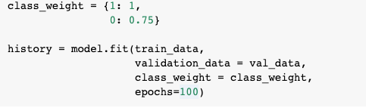
Processing - Model fitting
I used class weights to give more importance to ‘recall’ over ‘precision’. This helps the model to start with higher ‘recall’ and then it converges to high ‘precision’.

Slide 19
Processing - Overfitting
One of the main challenges with ANN models is overfitting. To avoid overfitting, I took several steps:
Carefully monitoring validation convergence: The final model showed great performance on both training and validation data
Applying DropOut layers after large dense layers: I used 50% drop out rate that helped a lot with over-fitting
Using multi-metric evaluation: Instead of just relying on the loss and accuracy values, I also quantified recall, precision and AUC to make sure the model is on the right track.

Slide 20
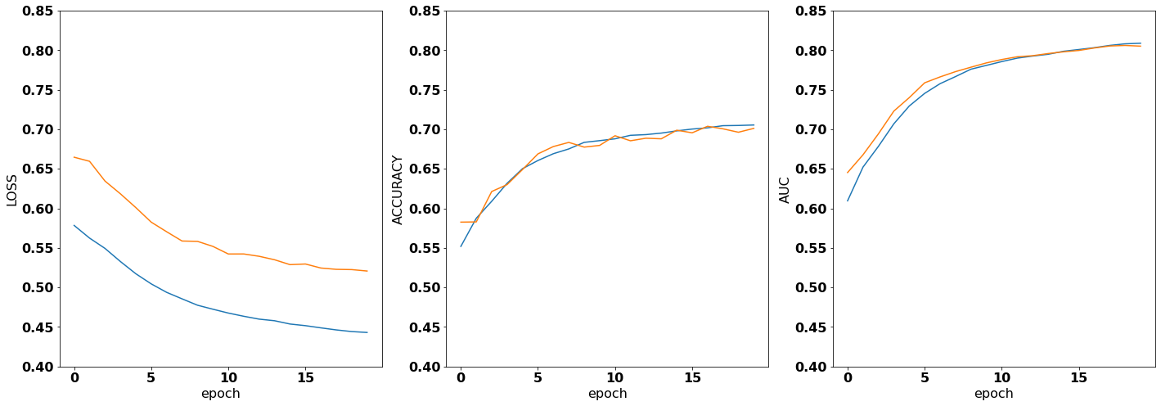
Post-processing: Initial Performance
Only with 20 epochs the tuned model was already on a satisfying trajectory.

Slide 21
Post-processing: Main approach
While I assigned a slightly higher weight to the `is_activated=1` class to enhance the initial recall and improve the convergence, I used the AUC (area under curve) metric to optimize the relationship between precision and recall. I let the model run until it converged to a satisfying AUC while (>0.80) and it went up to 0.86.
This approach ensures while the model has the overall high accuracy, it is also powerful in identifying all relevant (is_activated=1) data points.

Slide 22
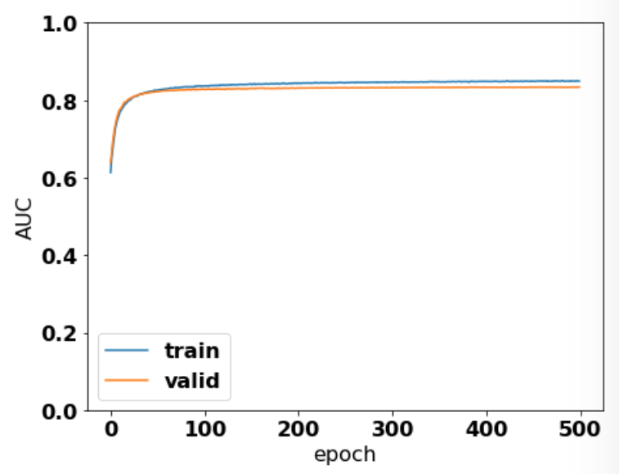
Post-processing: Overall Performance
I ran the model for a total of 500 epochs. The model run is relatively fast.
Data | Accuracy | AUC | Precision | Recall
Training | 75.0% | 86.0% | 72.2% | 79.8%
Validation | 72.7% | 83.3% | 70.6% | 78.4%
Test | 72.6% | 82.9% | 70.2% | 78.5%

Slide 23
Engineering Architecture and Trade-Offs:
Question: What does the engineering architecture to productionize one of the solutions looks like? What trade-offs would you use to productionize promising algorithms faster?
Answer: The fitted model can be used in a number of ways and mostly to predict the probability of a search that eventually is activated. This way we customize when the ad should be shown to the user based on a probability threshold, and decide when to show the ad to the user (when probability is high) and when not (when the probability is low).
By changing the model parameters and its layers, we may be able to make the model faster to be in the production but it should be noted that making the model faster may come in the expense of lower accuracy.
Another important trade-off is to tune the model on an optimal bias-variance relationship. This model like any ML model has a bias and a variance. Fitting it on a very large dataset might be time-consuming. If we want to lower the variance, the bias may increase and vice versa. An optimal configuration is to consider this trade-off when we want to increase the speed.

Slide 24
Business Performance and ROI
Question: Discuss how will you analyze the business performance of the algorithm once in production using metrics such as marketing ROI etc.?
Answer: One main aspect of this model is to increase the profit. We should see the bigger picture like this: every time an ad is shown to a user there is a probability that the user clicks on it or not. On the one hand, if we show an ad and the user does not get activated for any number of reasons, we have lost the money associated to showing the ad. On the other hand, if an interested user submits a search query and we do not show them the ad because of miscalculation or no calculation at all, we have lost a potential client and therefore lost a potential benefit. So it is important to find the right probability threshold. To put this in a marketing ROI (return of investment) framework, every ad is an ‘investment’ and an activated user is a ‘gain’. Therefore, the final goal should be to maximize this ratio: ROI = (total gain - total investment) / (total investment)

Slide 25
Code, Presentation and Repository
Code: The code and a self explanatory Jupyter Notebook is available from here:
https://colab.research.google.com/drive/1le1emKWg3kDgibay0SIrE6v0-VB460UZ?usp=sharing
Presentation: This presentation can be found from the following link:
https://docs.google.com/presentation/d/1bchwCkkt2tYCuIVC7vNqV2exXWL7l7Q15mca6QOwx_8/edit?usp=sharing
Repository: All the data and codes can be found from the following repository:
https://github.com/bnasr/FFN-CaseStudy

